Slide 1

Training Committee
Career Development Center, NITR
CV BUILDING SESSION

Slide 2
TABLE OF CONTENTS
01
General Instructions
02
Software & IT
03
Analytics & Consulting
04
Core

Slide 3
General Instructions

Slide 4
Why Make a Good Resume?

Slide 5
Points To Remember
01
Proper Format
02
Reverse Chronological Order
03
Don’t Fake
04
Interests
Must follow the 2 column Rahulworld latex format.
Arrange the work experience or achievements according to timeline.
Put Facts and never try to fake the interviewer.
Try to align the Resume according to the profile offered and company.

Slide 6
Basic Background
NAME
Programme | College Name Year, Department DOB Contact Email
Education Details
Branch Degree
Graduation Year

Slide 7
Links
&
Extra-Curricular
For Links mention all the important links you want to showcase.
Example
Github*
LinkedIn
Projects
Certificates
For Extra-Curricular
Mention your Position of Responsibility(PoR) in any event, society, club, SAC, etc
Mastery in any Art Form like Music/Painting/Photography etc.
Try to add Recent activity only.

Slide 8
SOFTWARE

Slide 9
SKILLS
General Programming:
C++, C, HTML, CSS, Javascript
Libraries/Frameworks:
React, Angular, Node, Express, Firebase

Slide 10
RELEVANT COURSES
Data Structures & Algorithms
Object-Oriented Programming
Database Management System
Operating Systems
Computer Networks

Slide 11
Industry Experiences
Projects
Any off-campus internships at startups or programmes like STEP, etc.
Hackathon Projects.(Flipkart Grid, EthIndia, Dr. Reddy’s, Amazon Hack-On and many more)
Technical Club Projects.(Cyborg, Google DSc. , Webwiz and many more).
Self Projects.

Slide 12
ACHIEVEMENTS
Should be limited to tech only. (Refrain from adding JEE ranks or pre-college achievements)
Hackathon Wins and Prizes, Pool Prizes
Contest Ranks( top 5 percent)
Profile Rank(Eg- Expert in Codeforces, 5* in Codechef, Cyan in Atcoder, etc.

Slide 13
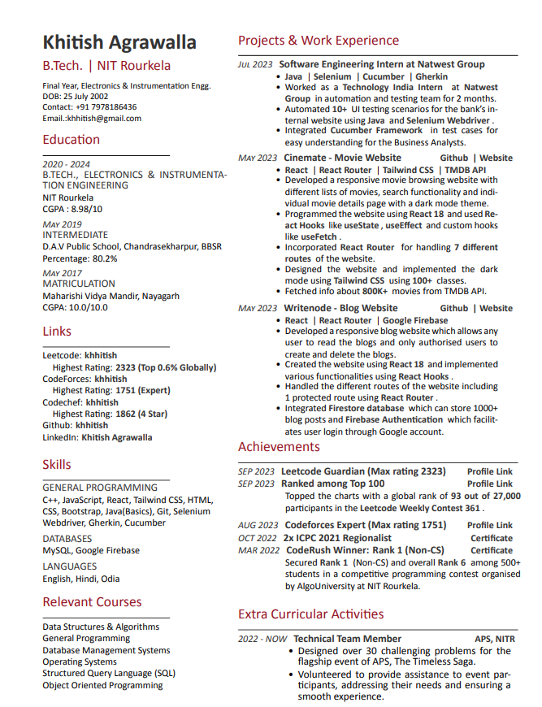
Good CV for a
Software Student (FTE)

Slide 14
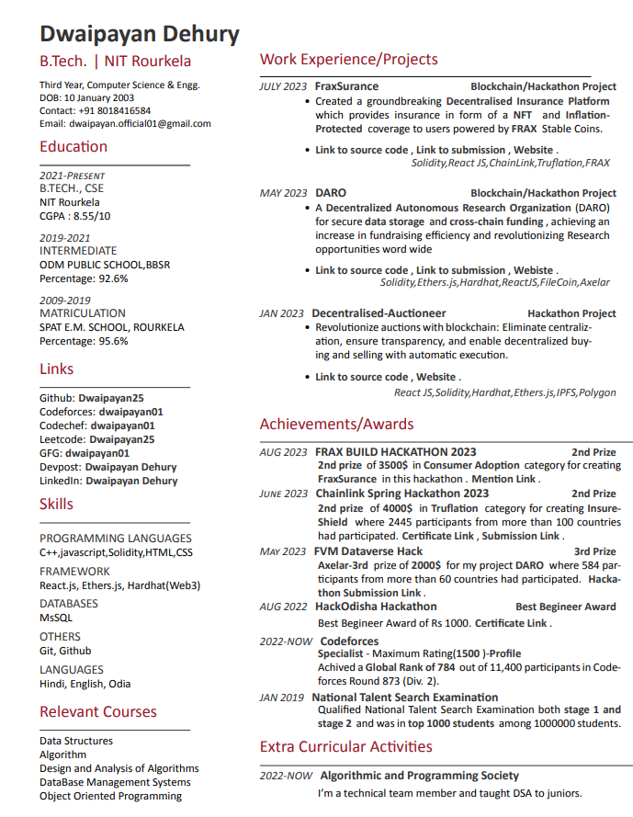
Good CV for a
Software Student (Intern)

Slide 15
Analytics

Slide 16
SKILLS
General Programming:
Programming (Python, R),C/C++
Software/Libraries:
Ms Excel, NumPy ,Pandas, PowerBI, Tableau , Matplotlib , Seaborn, OpenCV etc
Databases:
PostgreSQL, MySQL

Slide 17
RELEVANT COURSES
Database Management System
Statistical Analysis
Discrete Mathematics
Data Analysis
Data Visualisation
Intermediate Excel
Machine Learning
Structured Query Language(SQL)

Slide 18
Industry Experiences
Projects
Any on-campus , off-campus internships at startups or research programmes at different NITs and IITs.
Hackathon Projects.(ZS Campus Beats, UN Datathon, Dr. Reddy’s, Amazon Hack-On, GE Healthcare Precision Challenge, Case study competitions and many more)
Technical Club Projects.(Cyborg, Google DSc. , Webwiz and many more).
Self Projects.

Slide 19
ACHIEVEMENTS
& CERTIFICATIONS
Should be limited to tech only. (Refrain from adding JEE ranks or pre-college achievements)
Hackathon Wins and Prizes, Pool Prizes
Contest Ranks( top 5 percent)
Profile Rank(Eg- Expert ,Master or Grand Master in Kaggle etc.)
Course certification from Udemy , coursera , Microsoft , Google etc
Make sure you highlight the numbers properly and total number of participants.

Slide 20
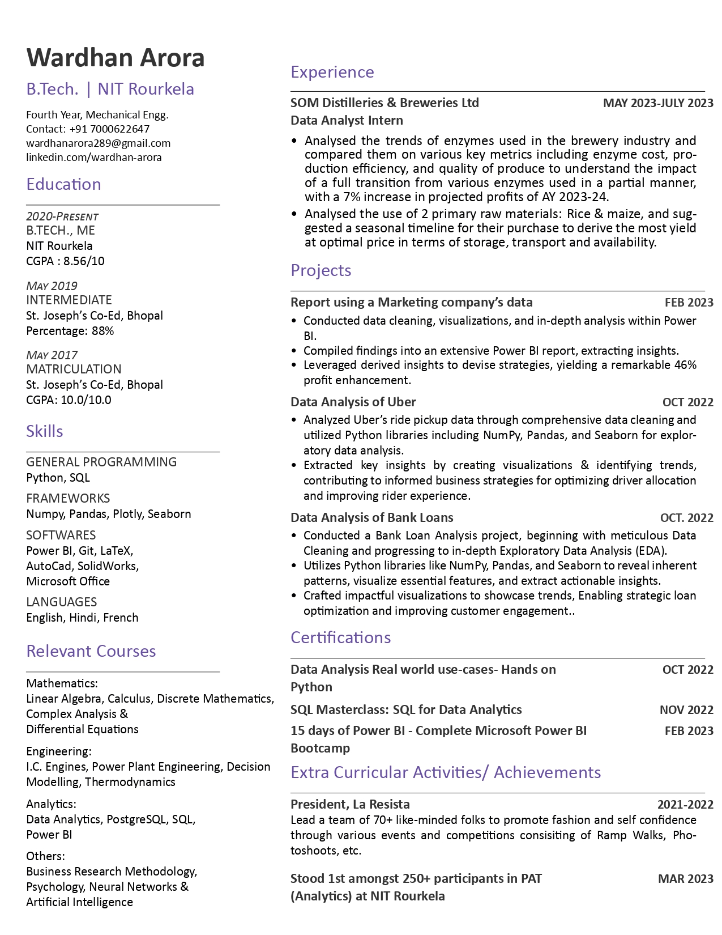
Good CV for a
Analytics Student (FTE)-1

Slide 21
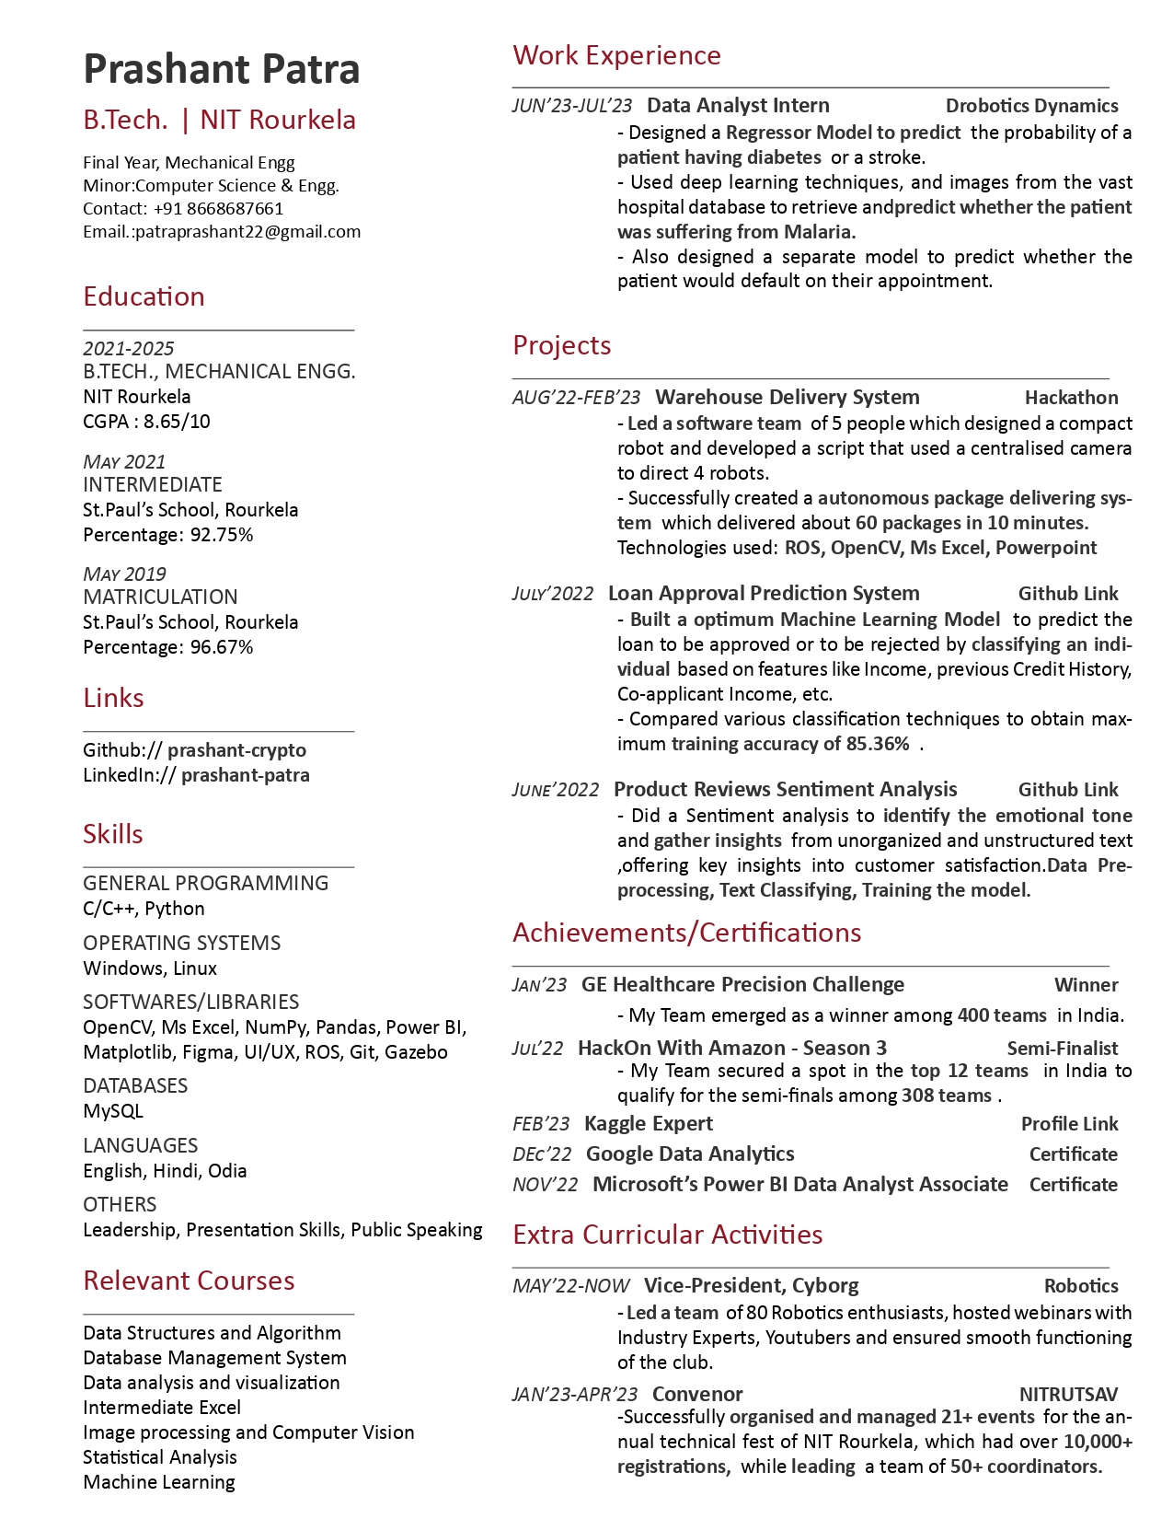
Good CV for a
Analytics
Student (FTE)-2

Slide 22
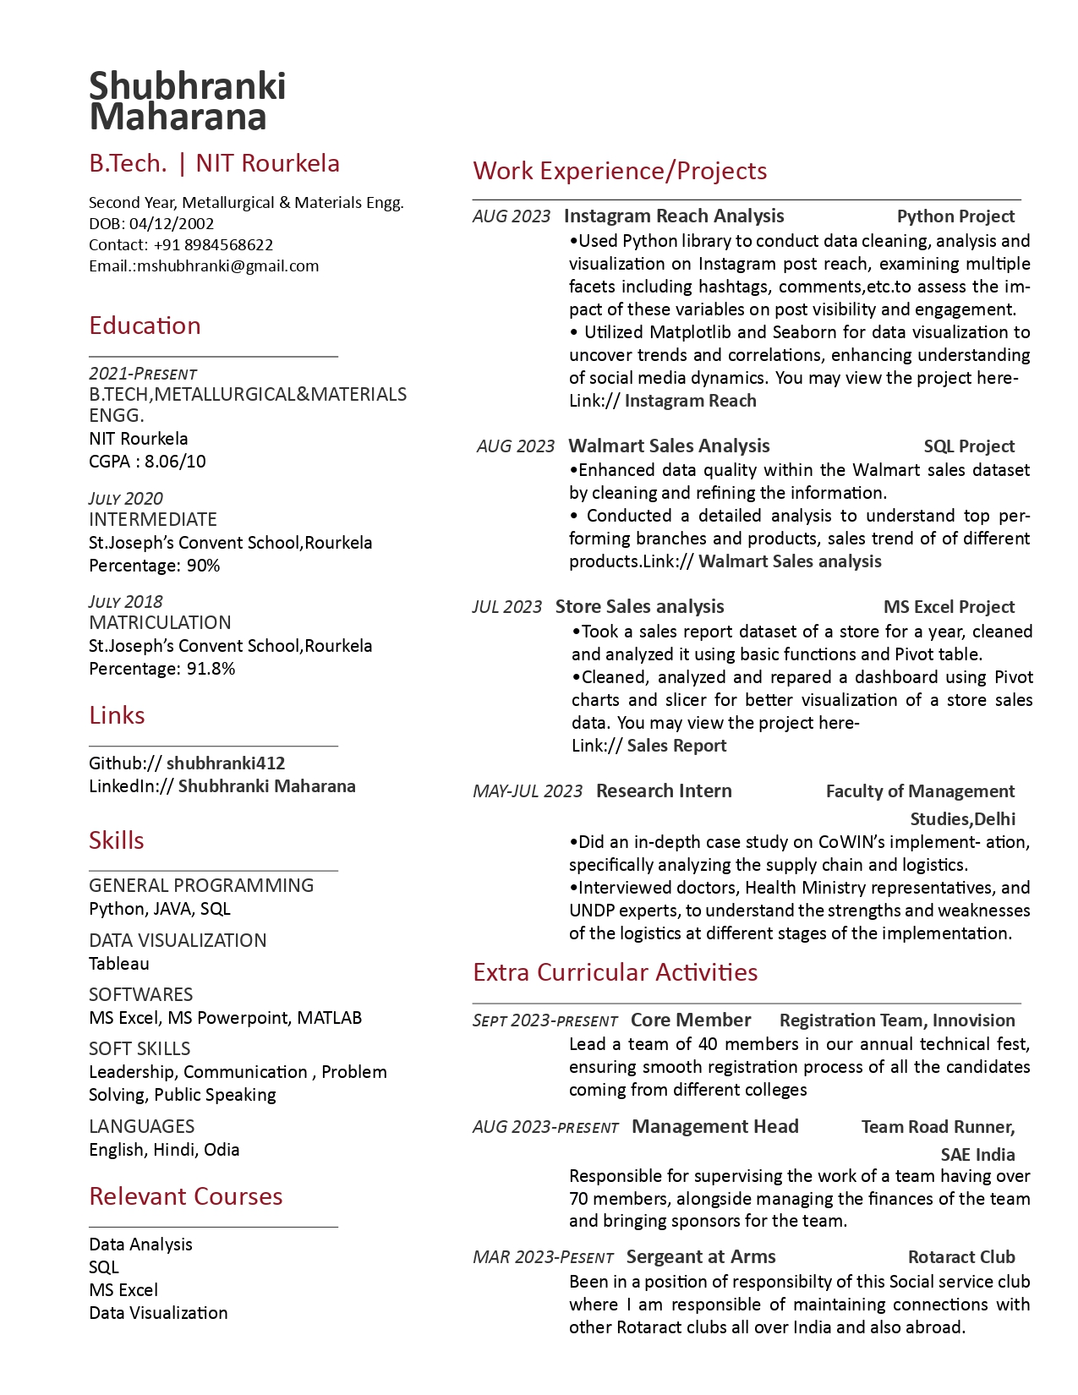
Good CV for a
Analytics
Student (Intern)

Slide 23
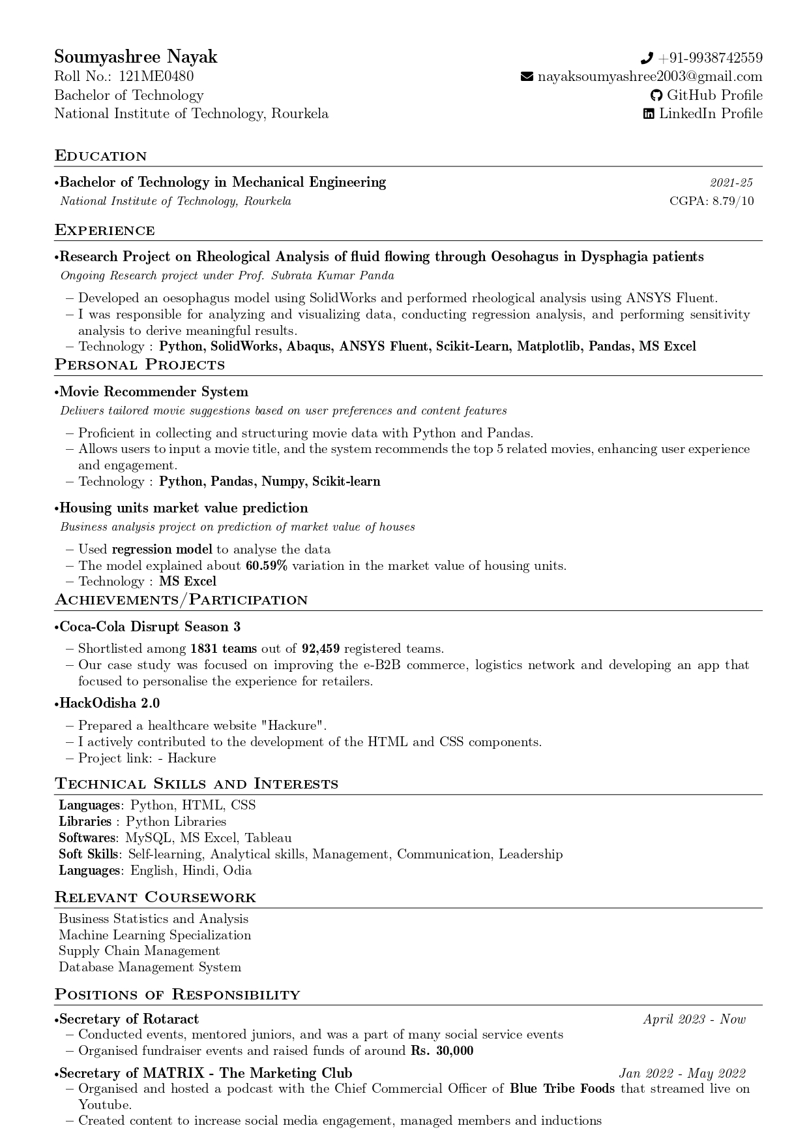
Good CV for a
Analytics
Student (Off-Campus)

Slide 24
CORE

Slide 25
SKILLS
General Programming:
MATLAB, C++, C, Python, …(Department specific)
Softwares:
ANSYS, ALTIUM, MULTISIM, COMSOL, ….(Course specific)

Slide 26
Relevant Courses
Firstly, Select the courses based on the profile you are being offered and the company you are applying to.
Secondly, Arrange the subjects according Strengths in those subjects. Put the subjects you are good at TOP.
You are advised to have some unconventional courses related to your core from the following:
NPTEL/edX/Coursera/Udemy.
Eg: Fundamentals of Automobile Engg. (ME Core) OR IOT
The course should be relevant with your core domain.

Slide 27
Work Experience
8-week Industrial Internship(the more,the better)
Research Internship
Industrial Visit/Vocational training
Projects under NIT/IIT Professor
Winter Internships (if any)

Slide 28
Research Internships
They are of 2 types :
Specific Internship Program.
Under IIT professor through cold mailing.
These are specific internship programs for second-years and third years. If you have good projects listed then you should definitely go for it.
Specific Internship Programs
TIPS:
Keep checking the dates from the respective websites.
Build a strong network through Linkedin.
The best time for applying for these internships is from Jan end to the first week of March.
Keep your SOP and Resume ready.
Keep a cold mailing template always ready with you.
SPARK(IITR)
SURGE(IITK)
SRIP(IITG)
Summer Internship (IISER KOLKATA)
SFP(IITM)
IAS(Indian Academy of Science)

Slide 29
Industrial Visit / Vocational training
Projects
NHPC
ONGC
SAIL
NPCIL
Vizag Steel Plant
RSP
OCPL
And many more
Don’t have any core projects. Best place to start is always under your college professors.
Technical Club Projects.(Cyborg, SAE and many more).
Self Projects.

Slide 30
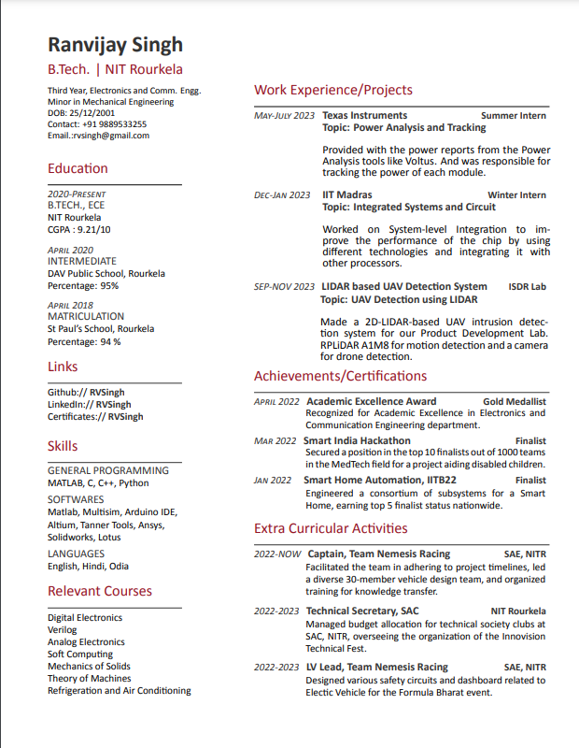
Good CV for a Core Student
FTE

Slide 31
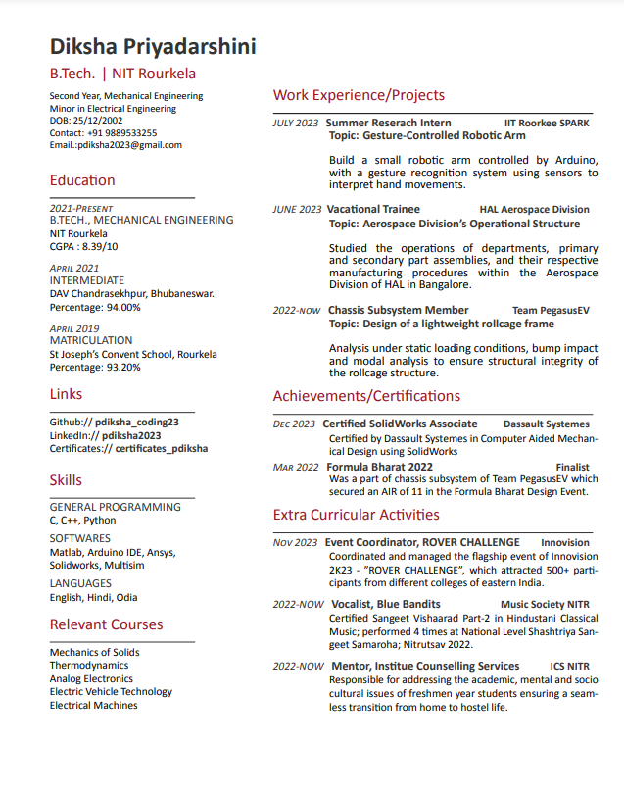
Good CV for a Core Student
Intern

Slide 32
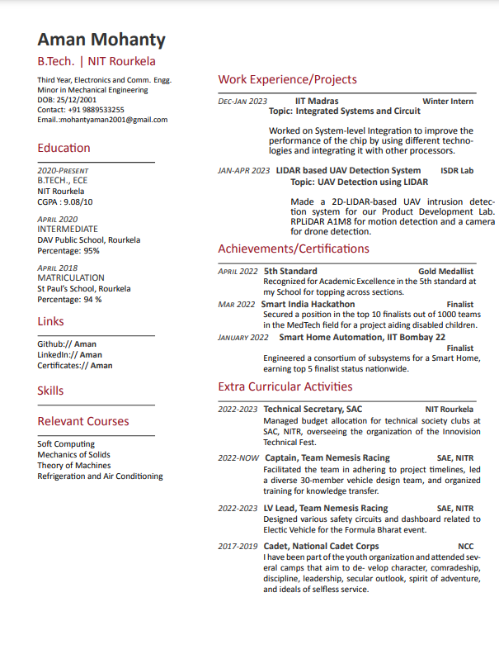
Don'ts for a CV
Misalignment of Roles and Timelines
Skills section is missing
Very Old Achievements are not to be mentioned.
Lot of empty space is left.
Creates unbalance b/w left and right columns

Slide 33
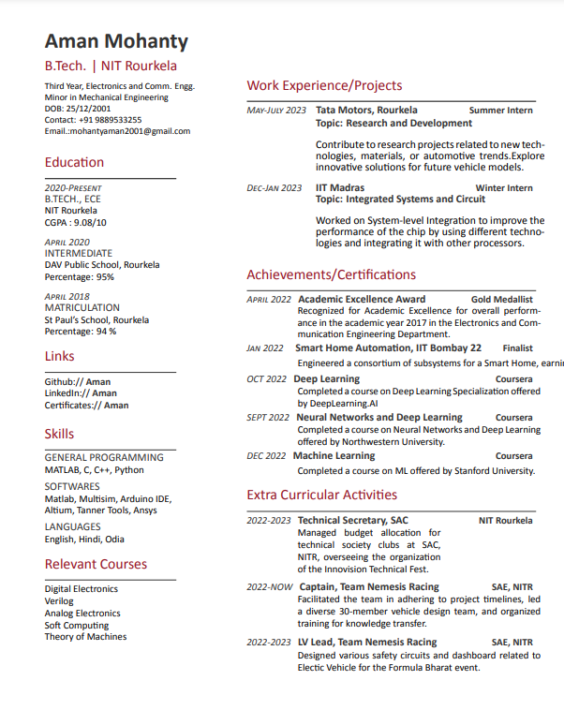
Don'ts for a CV
Not maintaining chronology of Achievements
Fake experiences.
Repetition of similar kind of courses/certifications/achievements does not add any value
Improper text width leading to bad alignment.

Slide 34
THANK YOU!
Now we will start with the QNA.

